Slide 1

2016 review / 2017 Programs
Hodge Products
2/1/2017

Slide 2
2016 /2017 analysis
2015 Full Year Net Sales - $4,526,313.27
2016 Full Year Net Sales - $4,632,956.27
Net Sales PYTD Variance – 2.36%

Slide 3
5 year analysis

Slide 4
5 year analysis

Slide 5
2017 Incentive Plan
Targets
4% Growth $ 4,818,274.40 - $ 48,182.74 payout
8% Growth $ 5,003,596.60 - $ 75,053.89 payout
12% Growth $ 5,188,910.90 - $ 103,778.21 payout
15+% Growth $ 5,327,899.60 - $ 133,197.49 payout

Slide 6
Awesome start to the year! Padlocks & safety

Slide 7
Observations

Slide 8
Observations
Bid Pricing –
Bid pricing is by definition, competitive bids with other manufacturers.
What is isn’t is “volume discount”
I need at least 2 things for bid pricing –
Complete end user name and address is mandatory – no getting around it
RFQ or some sort of documentation that I can supply to the bid manager
We have a system that we have to trust!

Slide 9
Observations
Forecasting – we’re getting better!
Where forecasting is needed and why –
Products from China
Chinese New Year
New product introductions
Technology – circuitry (BLE)
Examples –
Carded products – Ross Stores program
Brass Resettables
Safety Devices (new)
Lockboxes
Bluetooth
Where we don’t need to forecast
Products with US or MX COO
Laminated Steel
Pro Series
Safety Padlocks
Existing Safety Devices
175 & 175LH Brass (high volume/established)

Slide 10
New Products

Slide 11
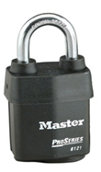
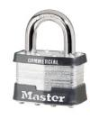
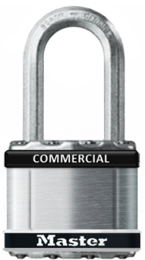
Commercial Magnum
Commercial Magnum provides an option for value-oriented customers to increase the security and weatherability of their padlocks, without the ProSeries® or solid body premium
Commercial Magnum Features and Benefits:
Dual Ball Bearing Locking provides higher security
Chrome Plated Steel Octagonal Shackle, for improved weatherability and cut resistance
Stainless Steel Top and Bottom Plate with a 304 Stainless Steel Sleeve for greater weather resistance
4-Pin Tumbler Brass Cylinder, including WP4 Edge Cylinder
Can key into existing K1 or WP4 Edge keyway
Non-Rekeyable
Top and Bottom Double Bumper
2 Sizes – M1STS (1-3/4”) and M5STS (2”) Magnum Lockbody
3 Shackle Lengths- 1”, 1-1/2”, 2-1/2”
Available August
2016
Commercial Laminated Steel
Commercial Magnum
Pro Series Weather Tough
List Price $14.98
List Price $17.98
List Price $24.51
Commercial Magnum bridges the price point gap between the Commercial Laminated and ProSeries®

Slide 12


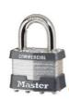
Commercial Laminated Padlock Price Progression
Price
$24.51
$17.98
$14.98
$14.25
#6121
2-1/4” Weather Tough Sleeve
#M5STS
2" SS Sleeve
$11.79
#5
2" Laminated
#M1STS
1-3/4" SS Sleeve
#1
1-3/4" Laminated
Performance

Slide 13
Hodge Products – New Products
S600 Series Group Lock Boxes
These new lock boxes have a rugged construction designed to withstand the toughest environments. All three models – the S600, S601 and S602 – are designed with a clear, impact-resistant window that allows participants in the lockout to view the keys secured inside.
The stackable design facilitates storage and simplifies the transportation of multiple boxes.
Each box has lock holes for up to 18 personal locks, plus an additional hole on the front latch for an operations lock.
The S601 is designed with a window along the long side of the box to provide users with a view of any unused locks during a lockout.
The large capacity S602 includes a rewriteable tag that can be used for procedure-specific information.

Slide 14
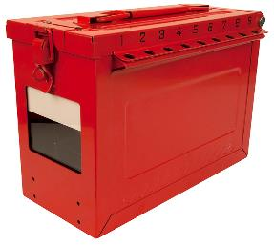
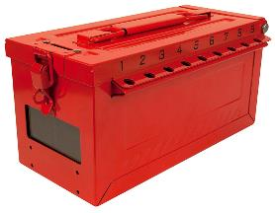
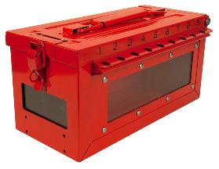

Product Offering Overview and List Prices
New Group Lock Box Line Up!
S600
Small Group Lock Box
List Price US$109.95
S601
Small Group Lock Box with Side Window
List Price US$109.95
S602
Large Group Lock Box with Rewriteable Tag
List Price US$139.95

Slide 15
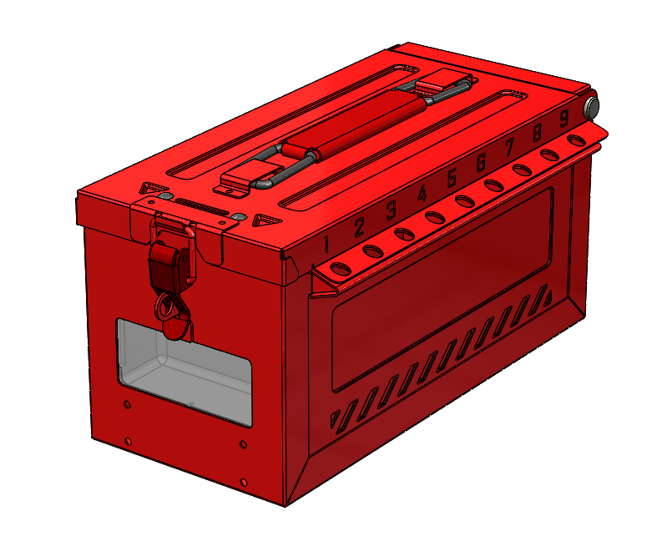
S600 Features and Benefits
430 grade stainless steel construction with heavy-duty powder coat provides high weatherability and corrosion resistance.
Key slot for dropping equipment lock keys into key cup.
Numbered lockout holes ease the identification of lock ownership during group lockout.
Lockout hole located in the latch provides for the attachment of the operations lock.
Clear, impact-resistant, polycarbonate window provides a clear line of sight to the equipment keys during a lockout.
Flanged lockout holes ease lock attachment: users do not have to “fish” shackles through the lid and box.
Tooled holes for riveting permanent metal identification tags.

Slide 16
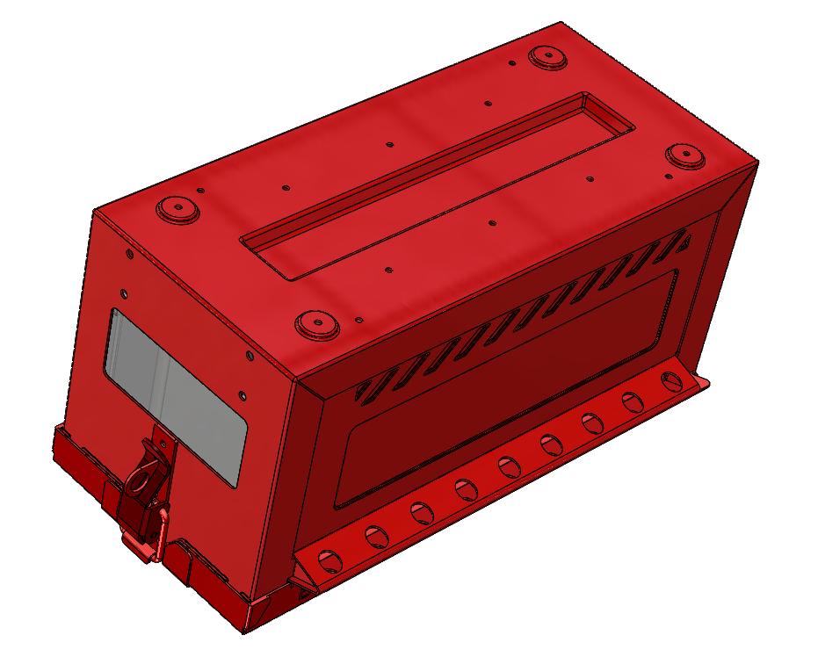
S600 Features and Benefits
Drain holes limit the ability for rain water or other liquids to accumulate inside the box.
Recessed bottom surface enables the lock boxes to be stack on top of each other.

Slide 17
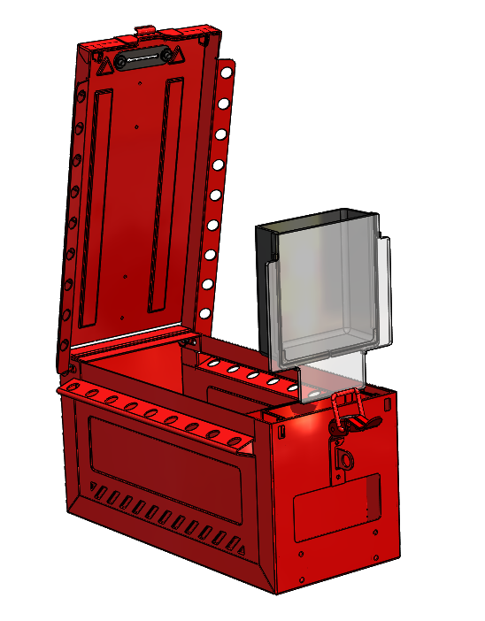
S600 Features and Benefits
Rubber gasket prevents the secured keys from falling back through the key slot when the box is inverted.
Removable key cup contains keys during the lockout, ensures keys are visible during the lockout, and provides ease in retrieving the keys once the lockout is complete.

Slide 18
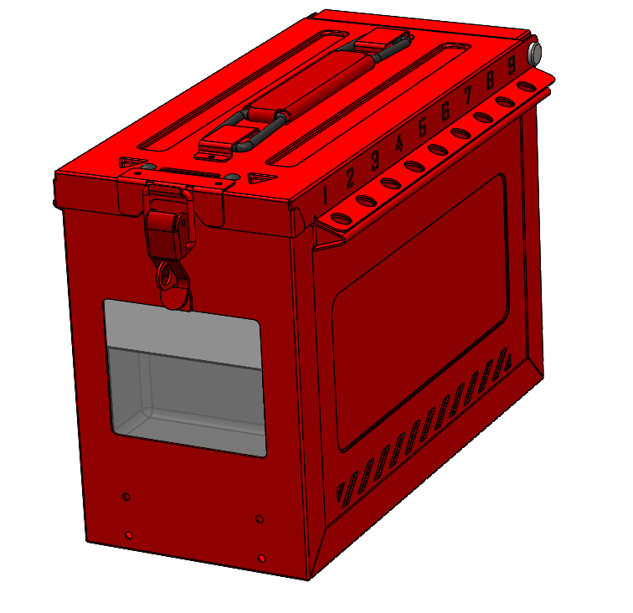
S602 Features and Benefits
Taller box provides greater lock storage capacity.
Re-writeable label enables users to temporarily mark the box with procedure-specific or other information.
The S602 has the same features as the S600, except as noted above.

Slide 19
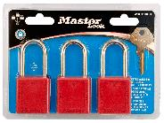
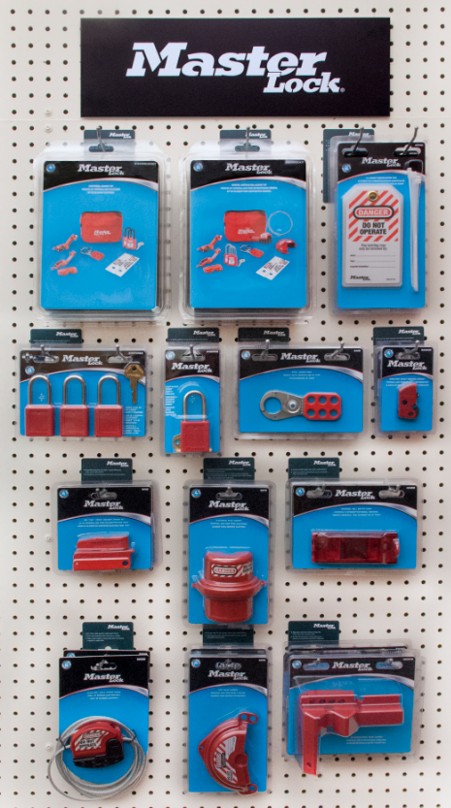

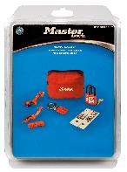
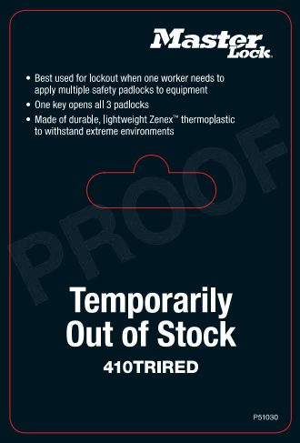
Hodge Products – Carded Safety Program
Carded Products
13 new “D” items.
Covers locks, tags, devices, kits.
Planogram Kits
4 MLC defined planograms.
Includes product and merchandising accessories.
Merchandising Kits
2 Merchandising Kits.
Merchandising accessories for distributors that display safety and/or security planograms.
Presents the Master Lock brand in the show room.
Drives incremental volume with existing distribution partners; captures walk-in, transactional business.

Slide 20
Carded Products
Product is priced at a 4% premium to the equivalent commercially packaged item (based on 2017 list prices).
All cards are trilingual: English, Canadian French, Latin American Spanish.
Master carton quantities of 6 for each item; MOQ is 1.
Padlocks have one key and tri-lingual label pack.

Slide 21
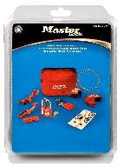
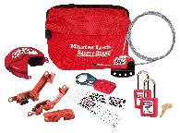
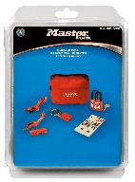
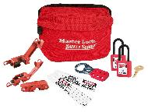
Carded Kits
S1010DGCKIT
(1) S1010 compact lockout pouch
(1) Set of 410 Zenex thermoplastic safety padlocks, keyed alike set of 2, red
(2) 493B Grip Tight™ Circuit Breaker Lockout, Standard Single and Double Toggles
(1) 491B Grip Tight™ Circuit Breaker Lockout, Tall and Wide Toggles
(1) 420 Steel Lockout Hasp, 1in (25mm) Jaw Clearance
(1) S297 Do Not Operate Safety Maintenance Tag, English
(1) 480 Rotating Gate Valve Lockout, 1in-3in (25mm-76mm) Diameter Handles
(1) S806 Adjustable Cable Lockout, 6ft (1.8m) Cable
List Price: $159.93
SKU # P50084
S1010DELECKIT
(1) S1010 compact lockout pouch
(1) Set of 406 dielectric Zenex thermoplastic safety padlocks, keyed alike set of 2, red
(2) 493B Grip Tight™ Circuit Breaker Lockout, Standard Single and Double Toggles
(1) 491B Grip Tight™ Circuit Breaker Lockout, Tall and Wide Toggles
(1) 420 Steel Lockout Hasp, 1in (25mm) Jaw Clearance
(1) S297 Do Not Operate Safety Maintenance Tag, English
List Price: $118.09
SKU # P50083
Product is priced at a 4% premium to the equivalent commercially packaged item (based on 2017 list prices).
All cards are trilingual: English, Canadian French, Latin American Spanish.
Master carton quantities of 4 for each item; MOQ is 1.

Slide 22
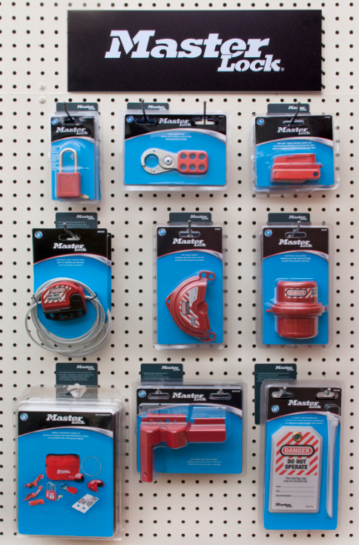
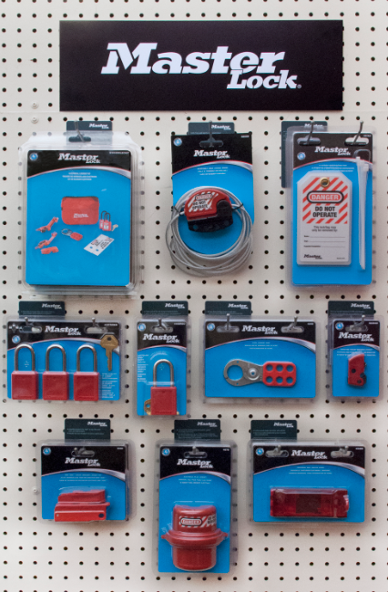
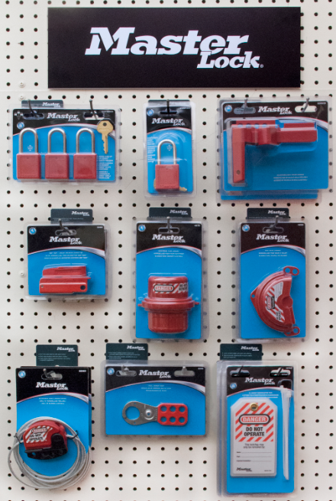
Planograms
4 Planograms in total: 2 focused on general industry, 1 each targeting electrical and plumbing contractors.
Each planogram kit contains product, planogram schematic, header, reorder cards, and hooks for hanging the product.
The set of re-order cards is the same for all planograms kits (they are not kit specific).
Pricing is a total of the product pricing. No pricing adder is included for the merchandising accessories.
1337SMGENIND
1336ELECT
1336PLMB
1337LGENIND

Slide 23
Hodge Products
Bluetooth Lock Box
5440D – Portable with shackle
5441D – Wall Mount
Release expected in May
Forecast in!
Communicated the commitment for stock of 600 units

Slide 24
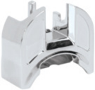
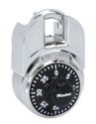
Hodge Products
Shackle Guard
1591, 1592, 1593, 1594, & 1596 Shackle Shroud
Model | Product Description | List Price
1591 | Master Lock 1502 combination lock with Shackle Shroud | $9.00
1592 | Master Lock 1525 combination lock with Shackle Shroud | $11.00
1593 | Master Lock 1572 combination lock with Shackle Shroud | $9.00
1594 | Master Lock 1585 combination lock with Shackle Shroud | $11.00
1596 | Shackle Shroud sold separately (will fit standard combination locks) | $4.00

Slide 25
Promotions

Slide 26
Hodge Products
2017 Portable Locker Lock Stocking Promo
Q1 Programs
Eligible Products -1525, 1585, 2010 and 2650

Slide 27
Hodge Products
2017 Portable Locker Lock Stocking Promo
Phase II - ??

Slide 28
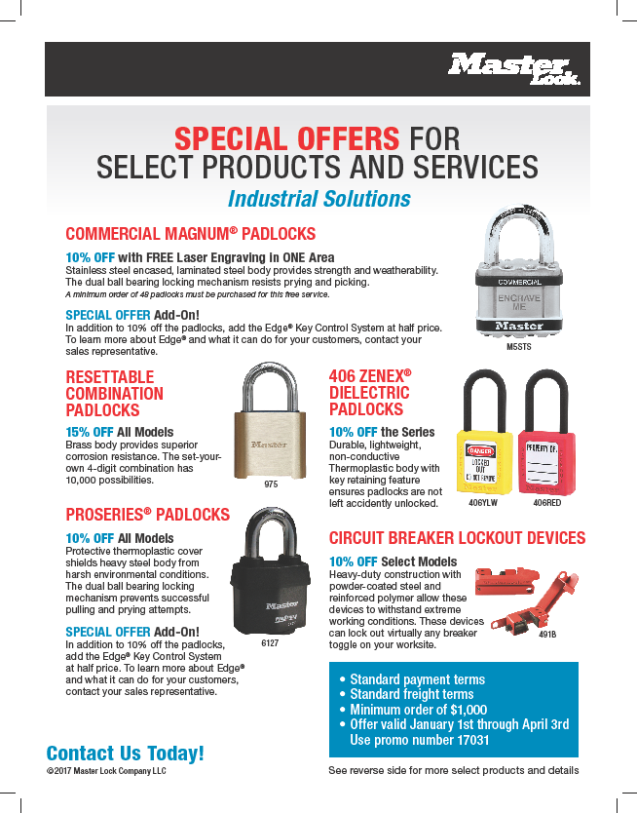
Hodge Products Q1 Promo
Standard Terms, Minimum Order $1000.00
Through April 3rd
Promo Number 17031
Commercial Magnum – 10% off, Free Engraving and 50% off Edge key control
Resettable Locks 15% off
406 Series 10% off
Pro Series 10% off
Electrical LO devices 10% off

Slide 29
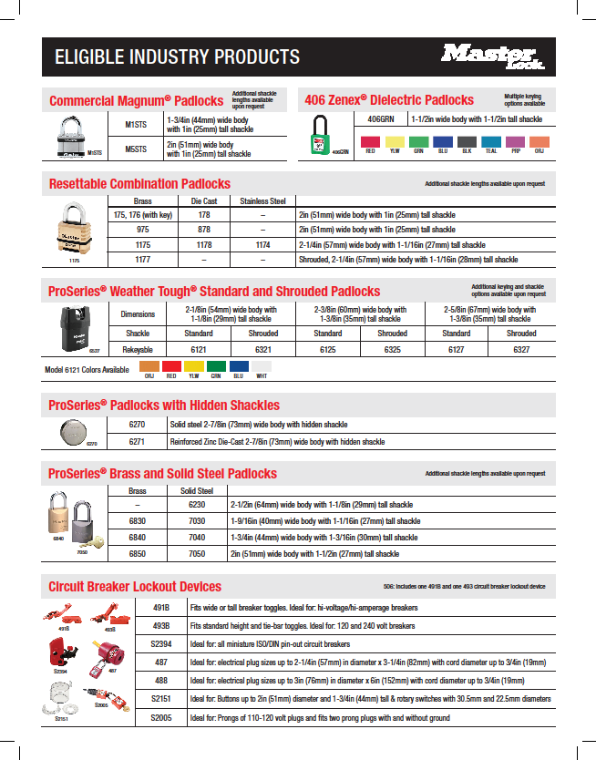
Hodge Products Q1 Promo - continued
Standard Terms, Minimum Order $1000.00
Through April 3rd
Promo Number 17031

Slide 30
questions?

Slide 31
Thank you!

